Slide 1
Istituto Comprensivo statale "GUIDO MONACO”
Rassina (AR)
Sezione SECONDARIA
Anno scolastico 2016/2017
CLIL
HISTORY OF ART IN ENGLISH
MARCO TOCCHI
classi coinvolte: 3A e 3B

Slide 2
PROGETTAZIONE DIDATTICA
4CS PLANNING GRID
4 CS PLANNING GRID
CONTENT | COGNITION | CULTURE | COMMUNICATION
To make a review of the most important artists and artworks studied during the year To read and understand a text with personal information about a painter’s style To understand oral information about paintings and painters To complete diagram and answer to simple questions about paintings To acquire a simple but specific language | To recognize the elements of the visual language To understand the differences between the colours To be able to classify the colours and understand the role of a colour in a painting | To understand the subject of a painting or an image To place temporally an artwork To be able to do a simple analysis of a painting To acquire a simple but specific language To know the most important cultural and artistic cities of the 20th century | To realize an oral and simple presentation of a painting To describe the subject of a paintings To improve the communication skills To apply art vocabulary and artistic concepts To be able to understand the English tagline of an exhibition

Slide 3
1ª LEZIONE
INTRODUCTION TO CLIL
INTRODUCTION TO A SIMPLE ANALYSIS OF A PAINTING
author
movement
period
elements of a visual lecture of the image
Discussion with the students based on the “question and answer” layout

Slide 4
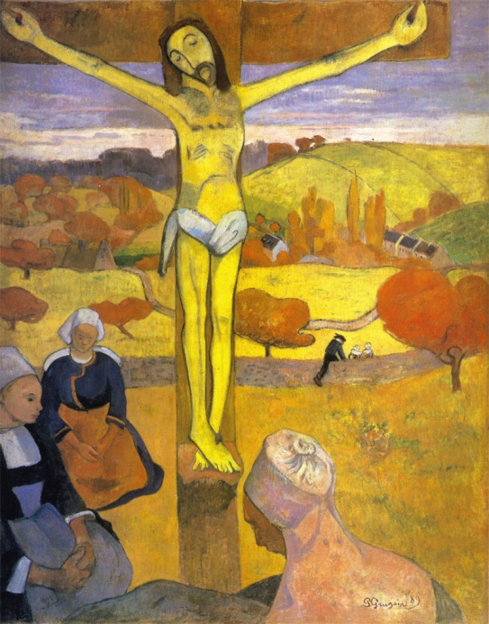
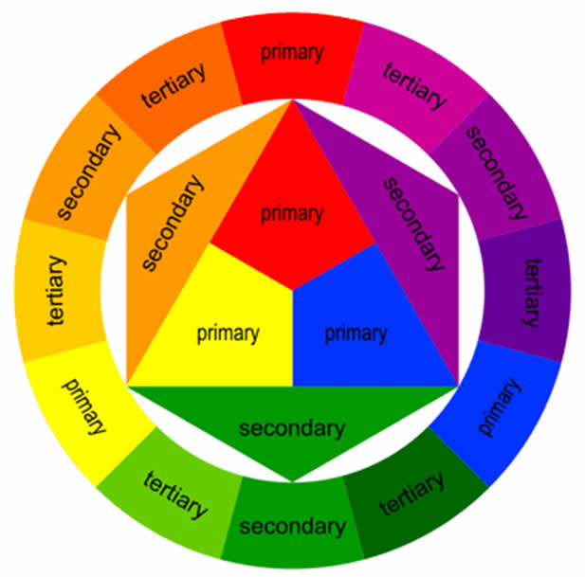
2ª LEZIONE
THE COLOURS OF THE PAINTINGS
Review of the theory of colour (primary, secondary, tertiary, warm and cold colours, analogous and complementary )and their use in a painting
Visual analysis of:
Monet C. - Ninfee
Van Gogh V. - Terrazza del caffè la sera
Gauguin P. - Cristo giallo

Slide 5
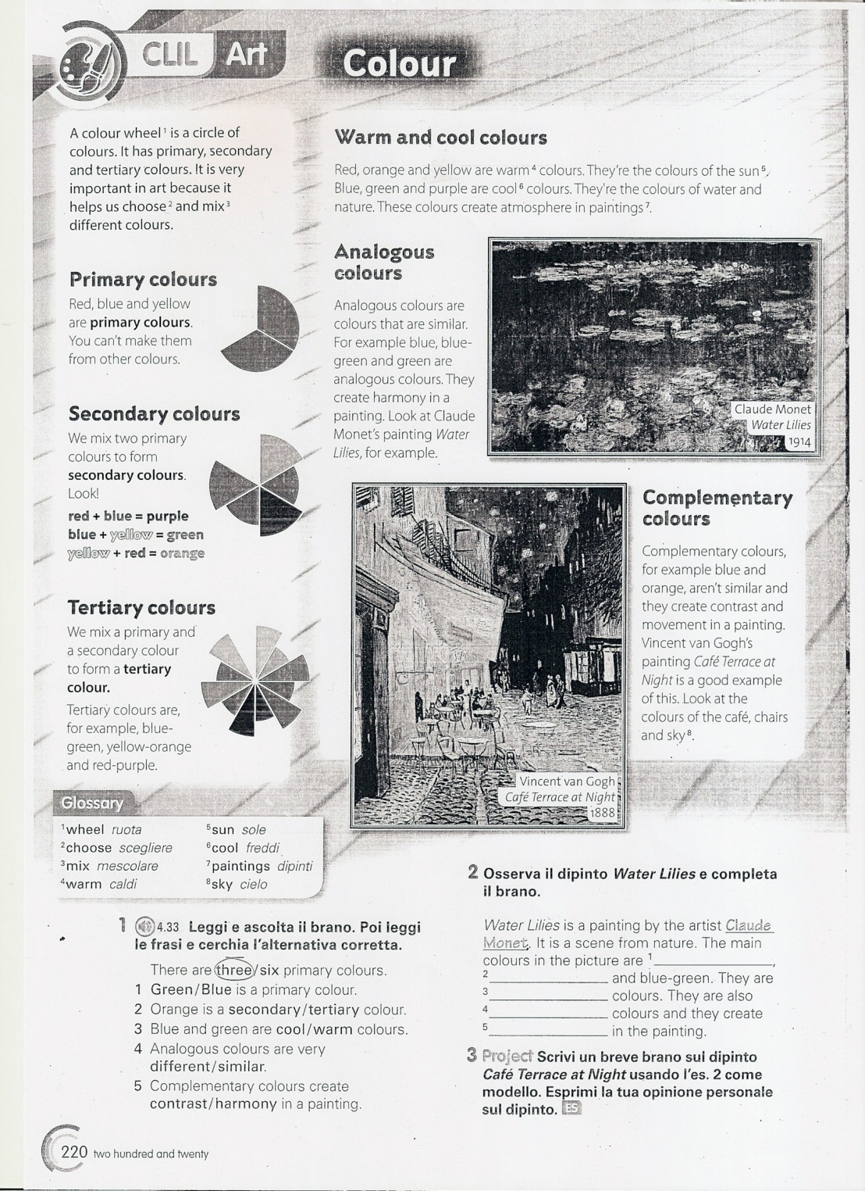

Slide 6
3ª LEZIONE
HISTORY OF ART IN ENGLISH AS “REVISION”
MODERN AND CONTEMPORARY ART HISTORY
MOVEMENT’S GLOSSARY AND TERMS
Abstract Art: art in which there is no subject; the art is made up of only shapes and colours.
Cubism: an art form developed by Pablo Picasso and Georges Braque; in cubism the artist would break up the subject into pieces and then rebuild it from different angles.
[...]
History Painting: a type of painting that used subjects from history.
Impressionism: a major art movement in Paris, France from the 1860s. A group of artists rebelled against the established art society and began to paint trying to capture the light and colour of the present moment. They became known as Impressionists.
Neoclassicism: a serious approach to art and architecture where classical models from the Greeks and the Romans were used.
[...]
The Salon: the official art exhibition taking place each year in France.
Surrealism: art that tries to capture the thoughts of the subconscious mind and dreams.
[...]

Slide 7
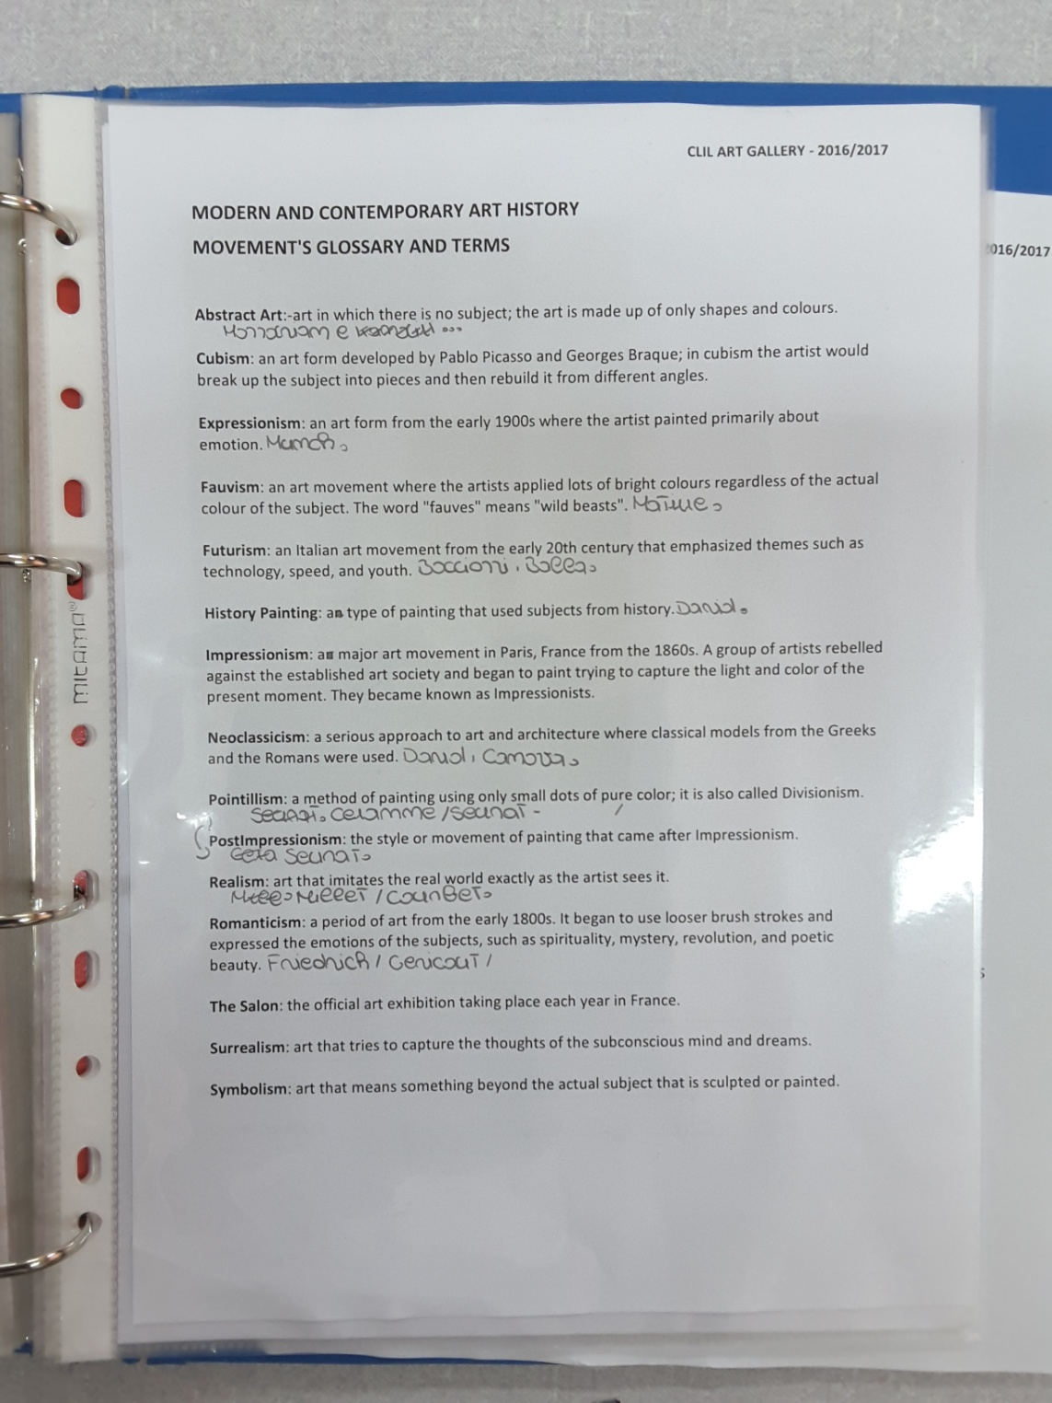

Slide 8
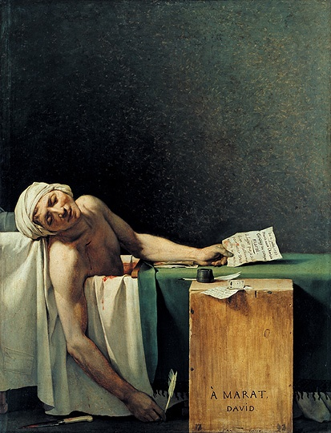
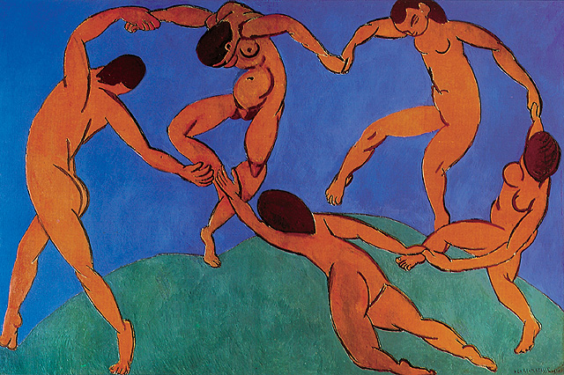
3ª LEZIONE
HISTORY OF ART IN ENGLISH AS “REVISION”
ARTWORK INFORMATION CARDS
Filling in the data about some important artwork
multiple choice
open answer
David J.L. - Morte di Marat
Géricault T. - La zattera della Medusa
Goya F. - Fucilazioni del 3 maggio 1808
Gauguin P. - Cristo giallo
Gauguin P. - La visione dopo il sermone
Van Gogh V. - Campo di grano con volo di corvi
Matisse H. - La danza

Slide 9
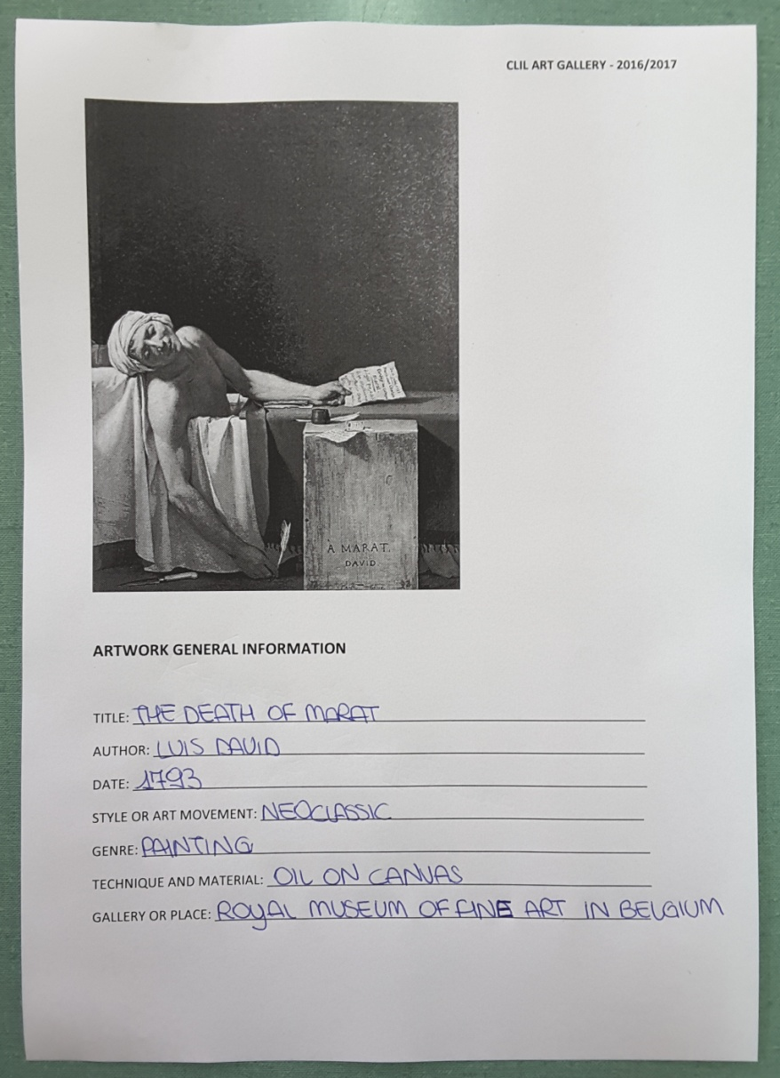
ARTWORK GENERAL INFORMATION
TITLE
AUTHOR
DATE
STYLE OR ART MOVEMENT
GENRE
TECHNIQUE AND MATERIAL
GALLERY OR PLACE

Slide 10
ARTWORK ANALISYS (multiple choice)
SUBJECT
◻ HISTORIC ◻ DAILY LIFE ◻ SIMBOLIC ◻ ABSTRACT
COLOUR'S USE
◻ PURE COLOURS ◻ CHIAROSCURO ◻ MONOCHROME
◻ WARM ◻ COLD ◻ COMPLEMETARY ◻ ANALOGOUS
◻ NATURALISTIC ◻ SIMBOLIC ◻ ABSTRACT
OBJECTS/SUBJECT REPRESENTATION
◻ DETAILED ◻ SIMPLIFIED ◻ DISTORT AND DEFORMED
SPACE REPRESENTATION
USE OF THE PERSPECTIVE ◻ SIMPLIFIED ◻ DISTORT AND DEFORMED
MOVEMENT REPRESENTATION
◻ STATIC IMAGE ◻ DINAMYC IMAGE

Slide 11
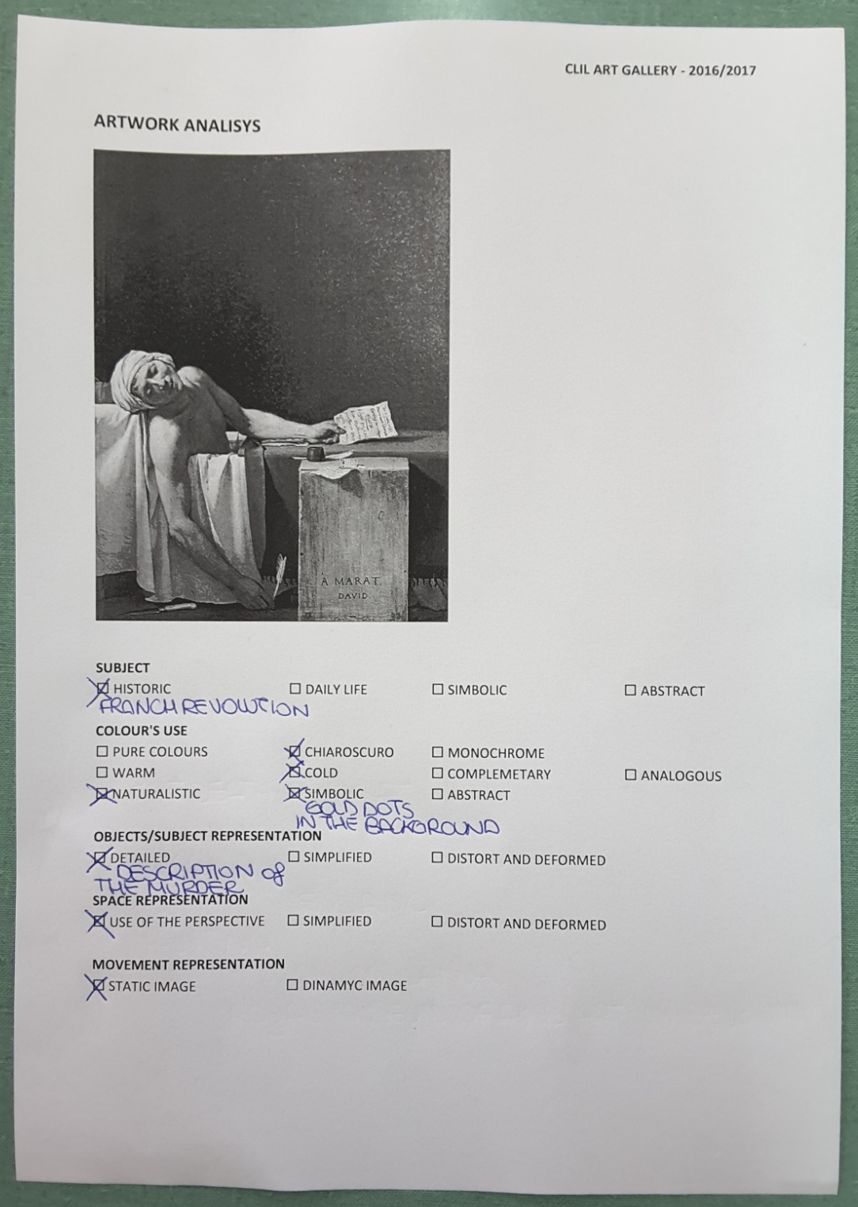

Slide 12
ARTWORK ANALISYS (open answer)
SUBJECT
COLOUR'S USE
OBJECTS/SUBJECT REPRESENTATION
SPACE REPRESENTATION
MOVEMENT REPRESENTATION
OTHER

Slide 13
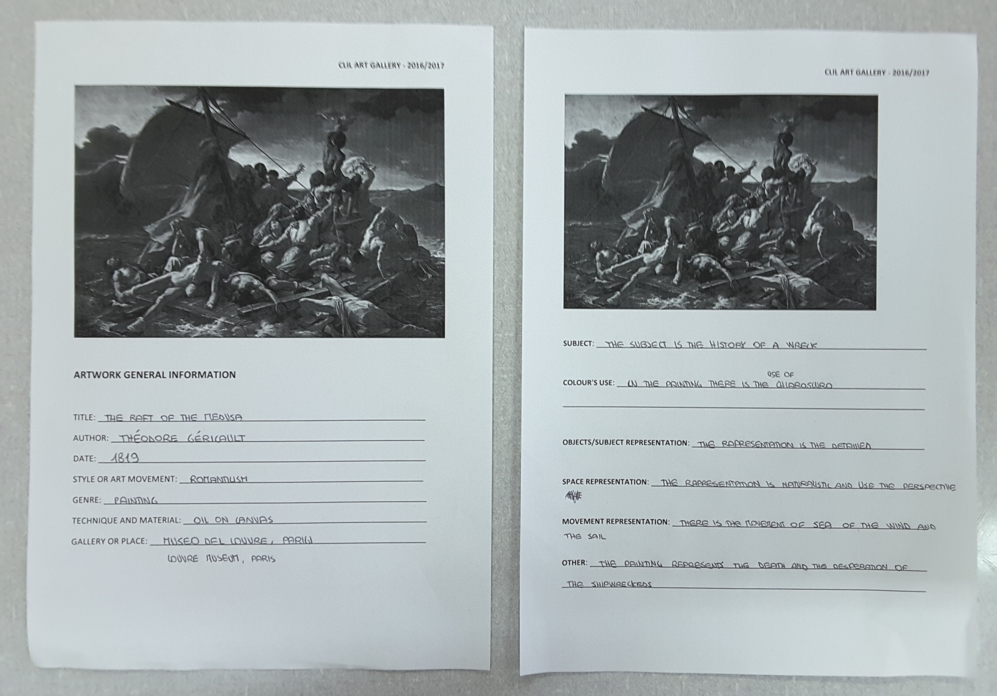

Slide 14
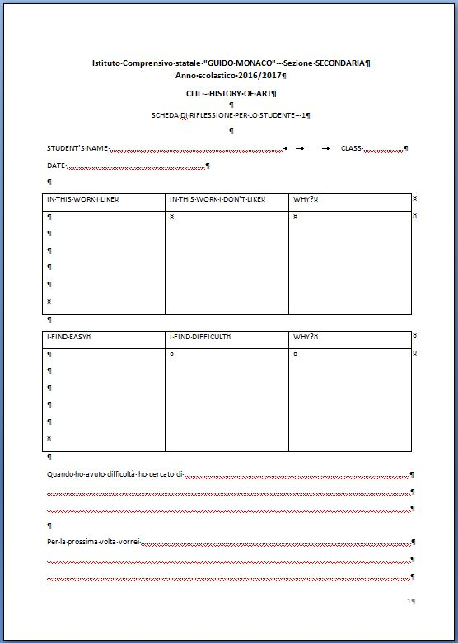
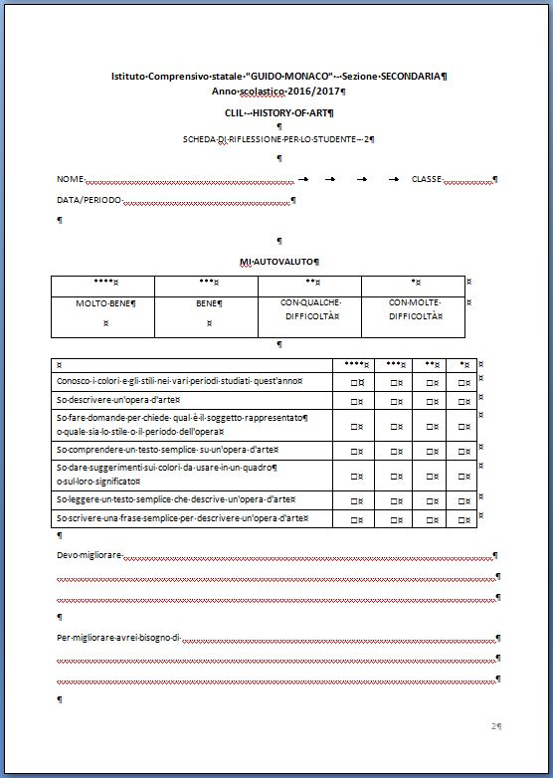
VALUTAZIONE DEL PROGETTO
SCHEDE DI RIFLESSIONE PER LO STUDENTE

Slide 15
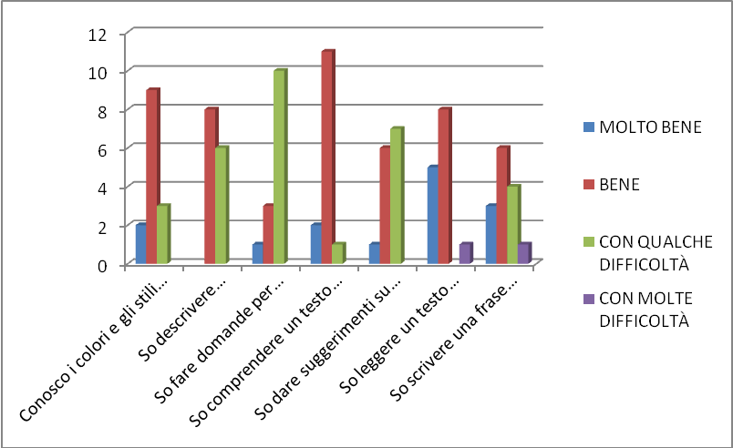
RISULTATI CLASSE 3 A (14 studenti)
SCHEDE DI RIFLESSIONE PER LO STUDENTE - 2
 | **** | *** | ** | *
Conosco i colori e gli stili nei vari periodi studiati quest'anno | 2 | 9 | 3
So descrivere un'opera d'arte |  | 8 | 6
So fare domande per chiede qual è il soggetto rappresentato o quale sia lo stile o il periodo dell'opera | 1 | 3 | 10
So comprendere un testo semplice su un'opera d'arte | 2 | 11 | 1
So dare suggerimenti sui colori da usare in un quadro o sul loro significato | 1 | 6 | 7
So leggere un testo semplice che descrive un'opera d'arte | 5 | 8 |  | 1
So scrivere una frase semplice per descrivere un'opera d'arte | 3 | 6 | 4 | 1

Slide 16
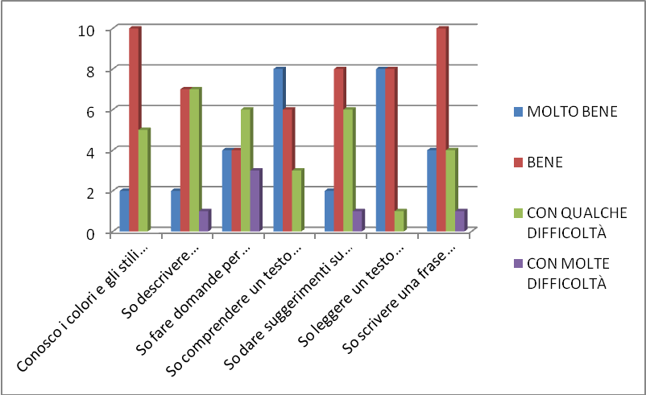
RISULTATI CLASSE 3 B (17 studenti)
SCHEDE DI RIFLESSIONE PER LO STUDENTE - 2
 | **** | *** | ** | *
Conosco i colori e gli stili nei vari periodi studiati quest'anno | 2 | 10 | 5
So descrivere un'opera d'arte | 2 | 7 | 7 | 1
So fare domande per chiede qual è il soggetto rappresentato o quale sia lo stile o il periodo dell'opera | 4 | 4 | 6 | 3
So comprendere un testo semplice su un'opera d'arte | 8 | 6 | 3
So dare suggerimenti sui colori da usare in un quadro o sul loro significato | 2 | 8 | 6 | 1
So leggere un testo semplice che descrive un'opera d'arte | 8 | 8 | 1
So scrivere una frase semplice per descrivere un'opera d'arte | 4 | 10 | 2

